Slide 1
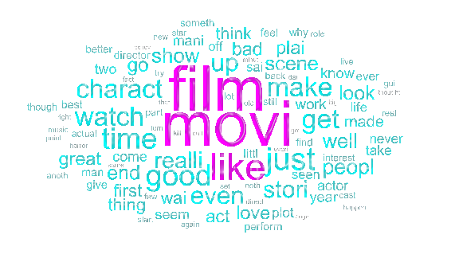

Introduction to Natural Language Processing
Machine Learning Methods – Lecture 24
fixelalgorithms.gitlab.io
June 2021
Or Yair

Slide 2


Natural Language Processing – Introduction

Slide 3




Bag of Words – Introduction

Slide 4



Bag of Words – Pre-processing

Slide 5
Bag of Words – Pre-processing

Slide 6
Bag of Words – Pre-processing

Slide 7


Bag of Words – Dictionary

Slide 8




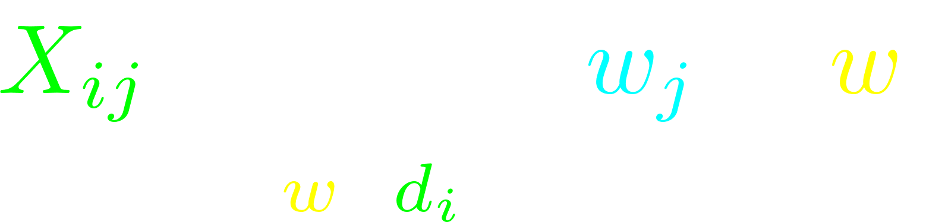
Bag of Words – Data

Slide 9


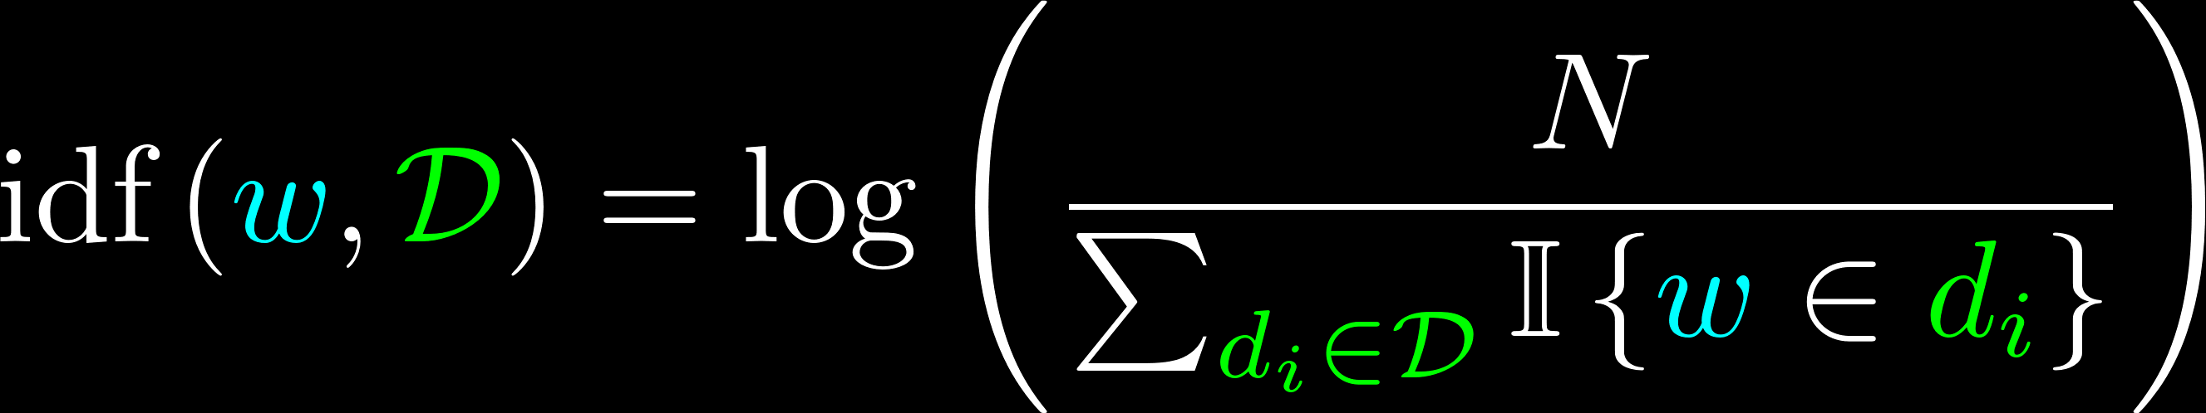

Term Frequency Inverse Document Frequency (TF-IDF)

Slide 10
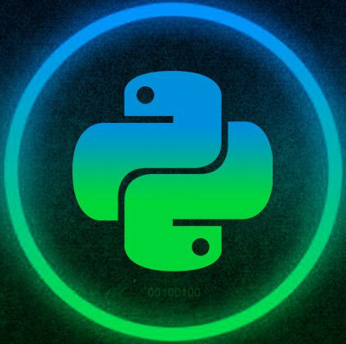
Bag of Words – IMDb Example
Bag of Words – IMDb

Slide 11




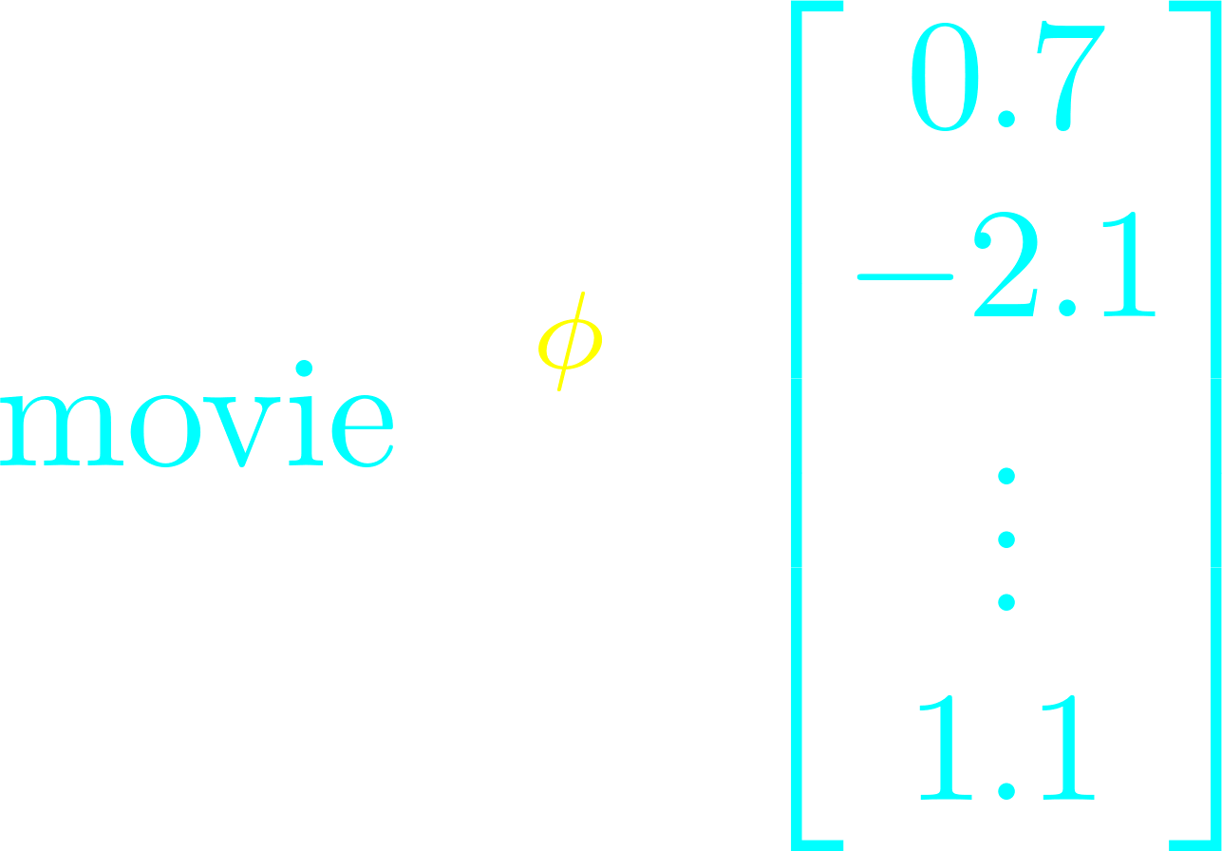






Word2Vec – Introduction

Slide 12


Word2Vec – Context Window

Slide 13
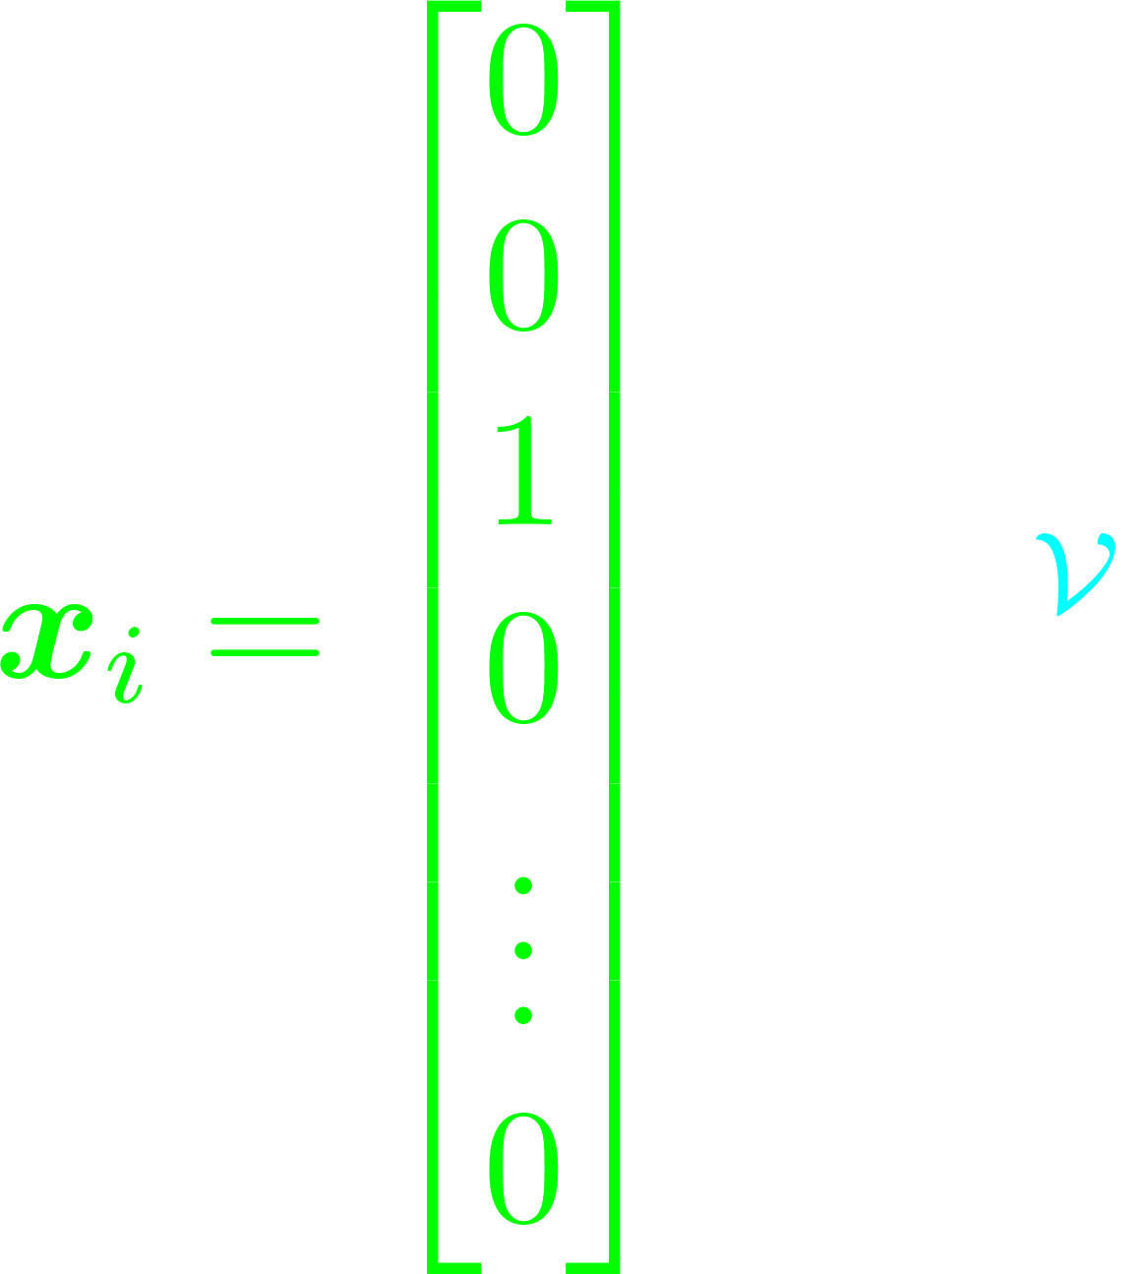


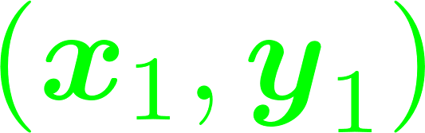
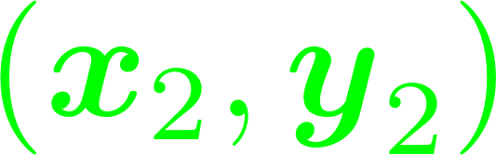
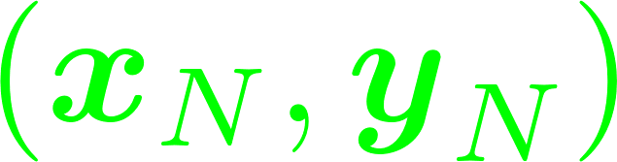

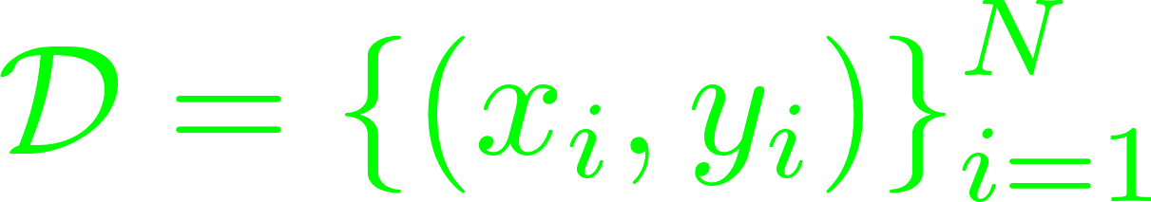
Word2Vec – One-hot Encoding

Slide 14

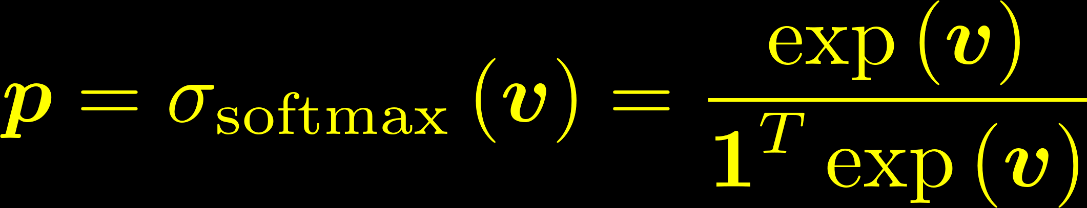
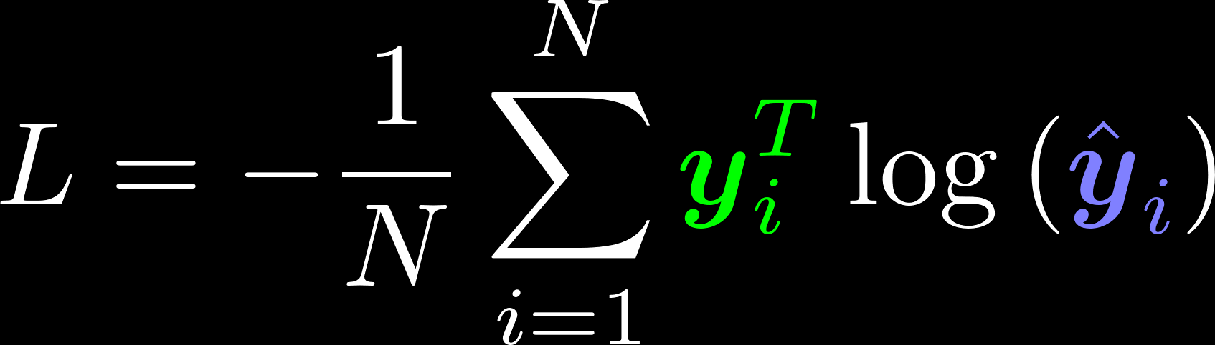
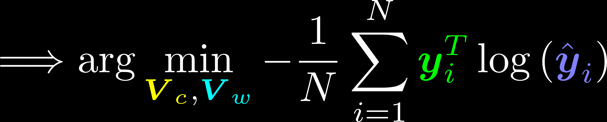
Architecture and Loss Function

Slide 15
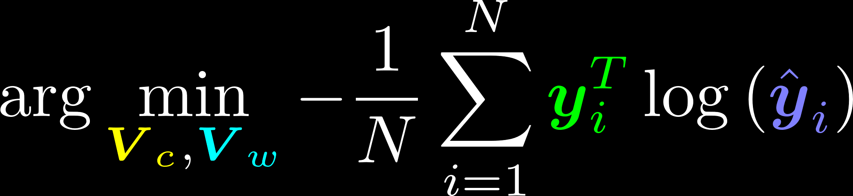








Word2Vec – Interpretation

Slide 16

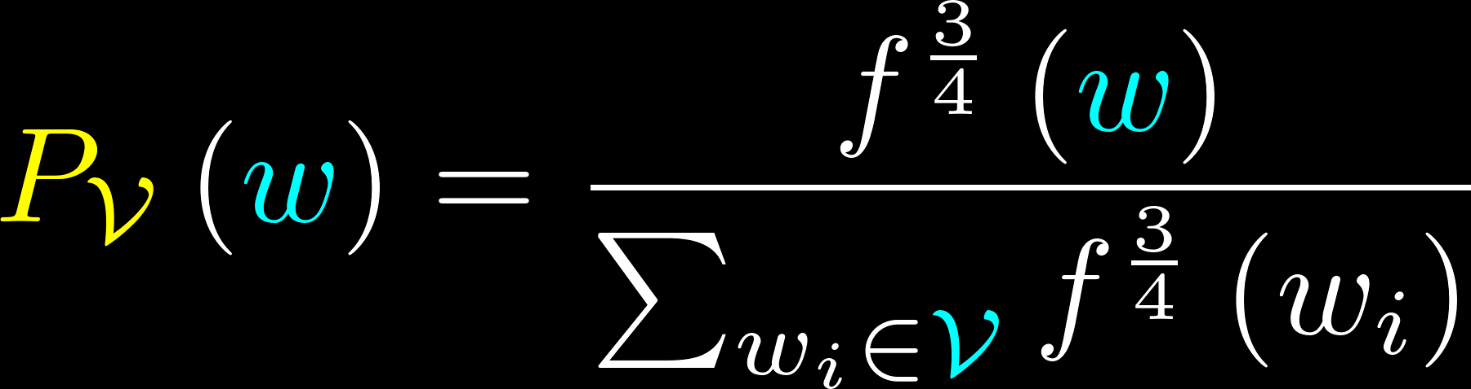
Word2Vec – Negative Sampling

Slide 17











Word2Vec – Negative Sampling

Slide 18
Word2Vec – Example
Word2Vec – IMDb

Slide 19



Questions
fixelalgorithms.gitlab.io

